Slide 1


Privacy-Preserving
Linear Regression
Break Through Tech Research Scholars
By Ariadna Fernandez and Sarah Athar
Research Advisor: Dr. Peihan Miao
Graduate Mentor: Shweta Srinivasan
CHI
Notes:
[BOTH]
Hello everyone
My name is Sarah A
And Ariadna F
We are both computer science undergrads
today we are going to talk about our research project which focuses on privacy preserving linear regression
Under the guidance of Dr Peihan Miao

Slide 2
Timeline
Deciding research topic
Look into possible implementations of Privacy-Preserving Data Deletion
Starting to Implement the Online Phase of the protocol
Finishing up protocol, and started training with the MNIST Database
WEEK 1
WEEK 3
WEEK 5
WEEK 7
WEEK 2
WEEK 4
WEEK 6
WEEK 8
Became familiar with cryptography primitives and Multi-Party Computation (MPC)
Decided to change project direction into a more practical approach
Continuing to work on the protocol
Improving accuracy, worked on presentation, and research journal
Notes:
[ARI]
Starting out, we had limited background knowledge on the topics of cryptography and ML, and the first two weeks of the project consisted on getting familiarized with the basics of the fields as well as reading the relevant literature and deciding on a topic to study more in depth.
We decided to continue with the topic of secure data deletion in machine learning models, however as we dove deeper we experienced some challenges while working through the theory concepts. After consulting with Dr. Peihan Miao we decided to shift gears in order to concentrate on a more practical approach, and being CS students, the best way to do that is through code.
Hence, we started our fourth week acquainting ourselves with Privacy-Preserving Linear Regression and how we could be implement it to better understand the inner workings of the cryptographic protocols detailed in the secure ML paper which is the base of our project.
The last four weeks consisted of working on a c++ implementation of the online phase of a privacy preserving linear regression algorithm.

Slide 3
The Problem:
Training Machine Learning (ML) models requires an immense amount of data collection which results in data privacy concerns for data owners that do not want to share sensitive information with other parties.
Privacy-Preserving Machine Learning
The Solution:
Privacy Preserving ML provides a solution to this security issue, by enabling companies to perform the same ML algorithm without knowing the underlying content of other parties’ data.
Notes:
[SARAH]
Such solution is proposed in the Secure ML: A System for Scalable Privacy-Preserving Machine Learning By Payman Mohassel and Yupeng Zhang paper which inspires our implementation Privacy Preserving Linear Regression Protocol.

Slide 4

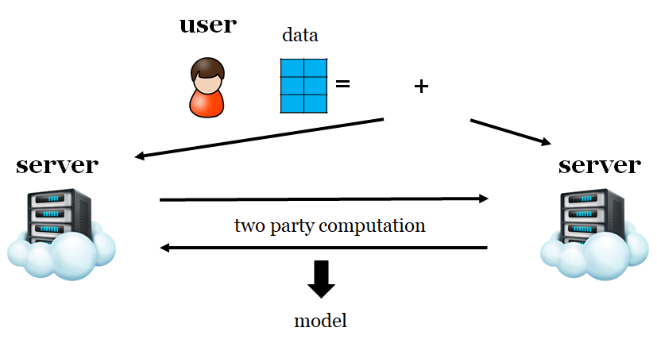

Two-Server Model and MPC
2 servers jointly train models, with secret-shared data
MPC- Multiparty Computation
Users can go offline after sharing the data, and do not need to interact with the servers during the training
Notes:
[SARAH]
Data is split into 2 shares, and sends each share to the 2 servers
In this way, a single server cannot learn anything about the original data since they have access to only a single share.
After, the servers interact with each other to perform a 2 party secure computation to generate the model
This protocol follows the two-server model, in which parties (clients) distribute their secret-shared data among two non-colluding servers who train the model on the client’s joint data by means of multiparty computation (MPC). Multiparty computation allows different parties to jointly train a model on their combined data inputs, while keeping their respective data private or hidden from other parties and revealing only the resulting predictive model.

Slide 5
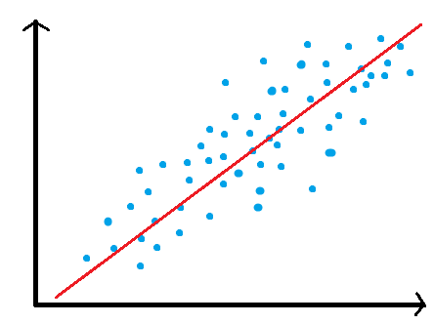

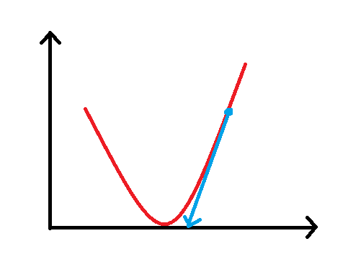

Linear Regression
Linear regression attempts to model the relationship between two variables by fitting a linear equation to observed data.
Stochastic Gradient Descent (SGD):
1.Initialize w randomly
2.Select a random sample (x, y)
3.Update
y
x
Input: Data Value Pairs - (x, y)
Output: Model w
w
Notes:
[ARI]
The goal of linear regression is to model the linear relationship between data value pairs x and y, where x represents a vector of d features and y represents a label.
A vector coefficient w models this relationship such that the predictive output which is the inner product of the features vector x with w, is approximately equal to the value y.
To train the model we use the SGD algorithm to find the best model w that minimises the difference between the predictive y_{i}* and y.
In this method, w is initialized as a vector of random values, and using a random sample computes a prediction of the current model w and compares it with the correct label and decides what is the best direction to move towards a more optimal w.
Repeatedly updating w using this equation for linear regression will eventually converge w to an optimal location.

Slide 6
Privacy Preserving Linear Regression
SGD: w_{i} = w_{i} − α(x · w − y) x_{i}
Users secret-share and distribute their data samples(x,y) to the two servers.
Servers initialize model w to random values and secret-share it.
Servers repeatedly run SGD using pre-computed Multiplication Triplets on the secret-shared values (offline phase).
Use truncation techniques on the resulting w while ensuring accuracy.
Notes:
Because SGD algorithm involves only a couple subtraction and multiplication, therefore the protocol we follow in our implementation applies secret sharing, truncation and secure arithmetic techniques to compute privacy preserving linear regression.
The computation can be summarized in these 4 steps.
** On step 3 REMEMBER to say that ‘which we will look at in more detail in the upcoming slides’

Slide 7
Secret-Share Multiplication
a
Notes:
Secret-sharing is a cryptographic primitive in which a piece of data, or ‘secret’, is kept private by having distinct owners hold a share of the secret. Not one party can guess or generate the original secret, which can only be reconstructed by combining the shares together. A value x that has been secret shared by two parties holding x₀ and x₁ is denoted as 〈x〉.
After data distribution happens in the setup phase, clients outsource the computation to the two servers and are not involved in any further computation. The protocol consists of an offline and online phase. The former is data-independent and consists of generating shared multiplication triplets, which are shared matrices consisting of random numbers in order to mask the data during computation.

Slide 8
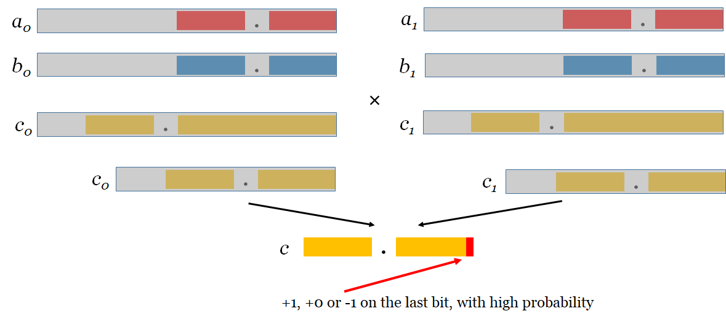
Truncation on Shared Values
First, a & b are secret shared between the 2 servers, masked by a large random number.
Then perform multiplication using pre-computed triplets to give us c, which encode the number which complete accuracy.
After, each share of c is truncated independently without any communication, t so that a fixed number of bits represent the fractional part.
We also note that the truncation does not affect security of the secret sharing as the shares are truncated independently by each party without any interaction
Notes:
A and B are secret shared betweem the 2 servers and are masked by a large random number
A and B are secret shares and once you multiply them keeping the accuracy you get C which is double the Size of the decimal part

Slide 9
Details on our Implementation (Online Phase):
Assuming that the clients have already secret-shared their data to the two
non-concluding servers and that multiplication triplets vital for computation have formerly been
generated in the offline phase. However, our implementation concentrates on the online phase,
and we achieve these two setup steps by simpler non cryptographic techniques.
Once each server holds their shares of the training data 〈X〉i and 〈Y〉i, and random shared
multiplication triplets 〈U〉i
, 〈V〉i
, 〈Z〉i, 〈V’〉i
, 〈Z’〉i have been generated for i ϵ {0, 1}
Offline Phase
Online Phase
OFFLINE
Generate the Necessary Multiplication triplets.
All communication in the offline phase can be done in one interaction.
Data Independent.
Does not involve any cryptographic operations.
Consists mainly of integer multiplications
Involves bit shifting, during truncation.
Trains the model given the data
Notes:
Vectorization, i.e. operating on matrices and vectors, is critical in efficiency of plaintext training. We show how to benefit from the same vectorization techniques in the shared setting. For instance, in the offline phase of our protocols which consists of generating many multiplication triplets, we propose and implement two solutions based on linearly homomorphic encryption (LHE) and oblivious transfer.
Oblivious transfer (OT) is a fundamental cryptographic primitive that is commonly used as building block in MPC.
We describe how to implement the offline phase as a two-party protocol between S0 and S1 by generating the desired shared multiplication triplets. We present two protocols for doing so based on linearly homomorphic encryption (LHE) and oblivious transfer (OT). The techniques are similar to prior work (e.g., [17]) but are optimized for the vectorized scenario where we operate on matrices.
Oblivious Transfer is used as a means to generate Multiplication triplets.
Series of Mini-batch indices are agreed upon by the 2 servers
the offline phase of our protocols is data independent. The servers and the clients can start the offline phase with basic knowledge on the bounds of the dataset size, while the bulk of the computation in the two prior work need to be performed after obtaining the data.

Slide 10
Future Work
Implementing the Offline Phase, which computes the Multiplication Triplets using more advanced cryptographic protocols.
Establishing a communication channel between the two servers.
Learning rate adjustment.
Further testing of performance with MNIST Database.
Notes:
Since our work focus on the implementation of the online phase, future work would involve:

Slide 11
Special Thanks to
Dr. Peihan Miao, Shweta Srinivasan and Break Through Tech for the opportunity!
Q&A!!
CHI

